Slide 1
SMART PATIENT DATASECURITY SYSTEM
Team member1:Vaishali S
Roll no: 2023PECCS433
Team member1:Uvashree S
Roll no: 2023PECCS432
Department : CSE
Guide name : Mrs.Sharmila
Domin: Healthcare

Slide 2
INTRODUCTION
Patient records contain highly sensitive personal information.
Need for a secure system to prevent unauthorized access and data breaches.
Smart Patient Data Security System ensures confidentiality and integrity of medical data.
Provides real-time monitoring and controlled access for authorized users.
Enhances trust, privacy, and efficiency in healthcare data management.

Slide 3
OBJECTIVE
To ensure secure storage and transmission of patient health data.
To prevent unauthorized access and protect patient privacy.
To implement encryption and authentication for data integrity.
To enable real-time monitoring of data access and system activities.
To build a trustworthy digital healthcare environment through smart security mechanisms.

Slide 4
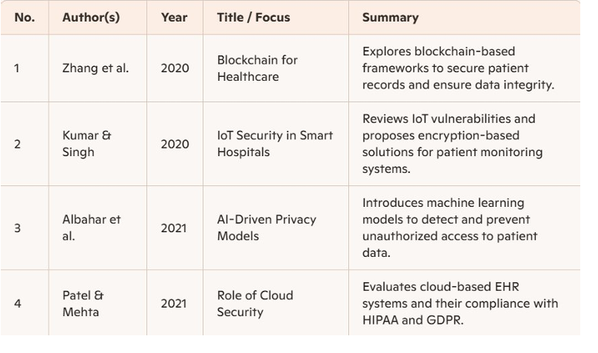
LITERATURE SURVEY

Slide 5
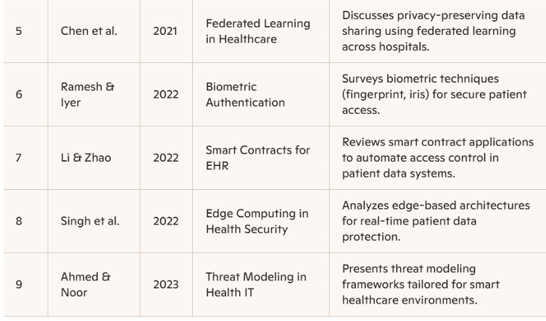

Slide 6
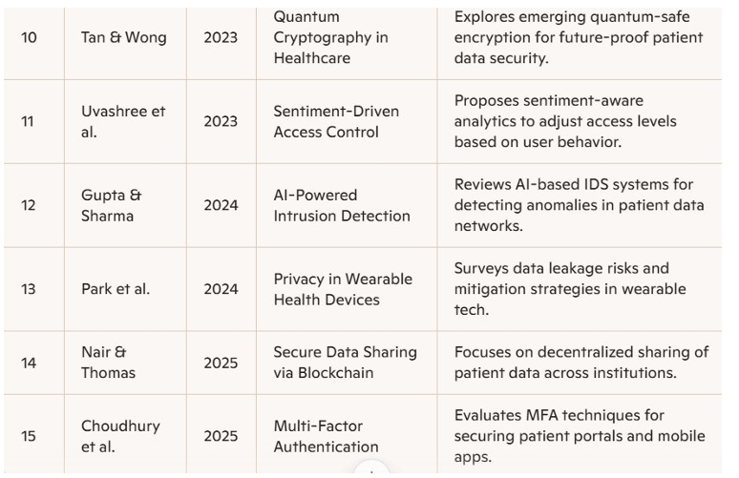

Slide 7
PROBLEM STATEMENT
Healthcare systems store large amounts of sensitive patient data digitally.
Unauthorized access, data breaches, and cyberattacks are increasing rapidly.
Many hospitals lack robust security mechanisms to protect medical information.
Manual data handling leads to privacy risks and human errors.
There is a need for an intelligent, automated system to ensure data security and patient confidentiality.

Slide 8
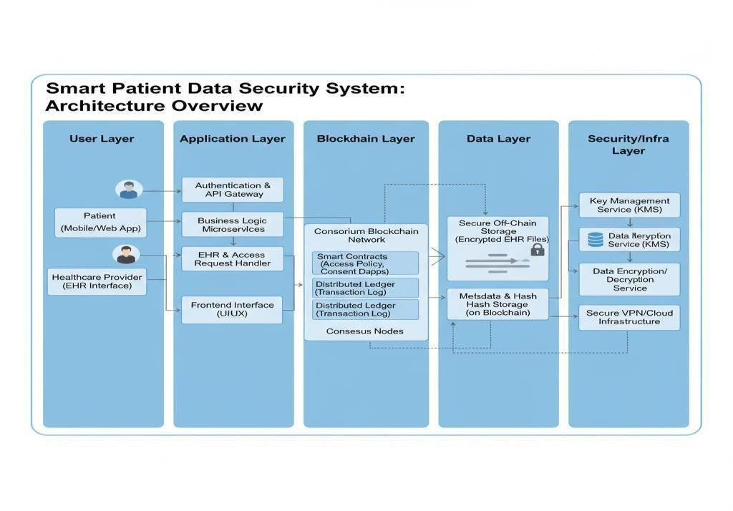
ARCHITECTURE DIAGRAM

Slide 9
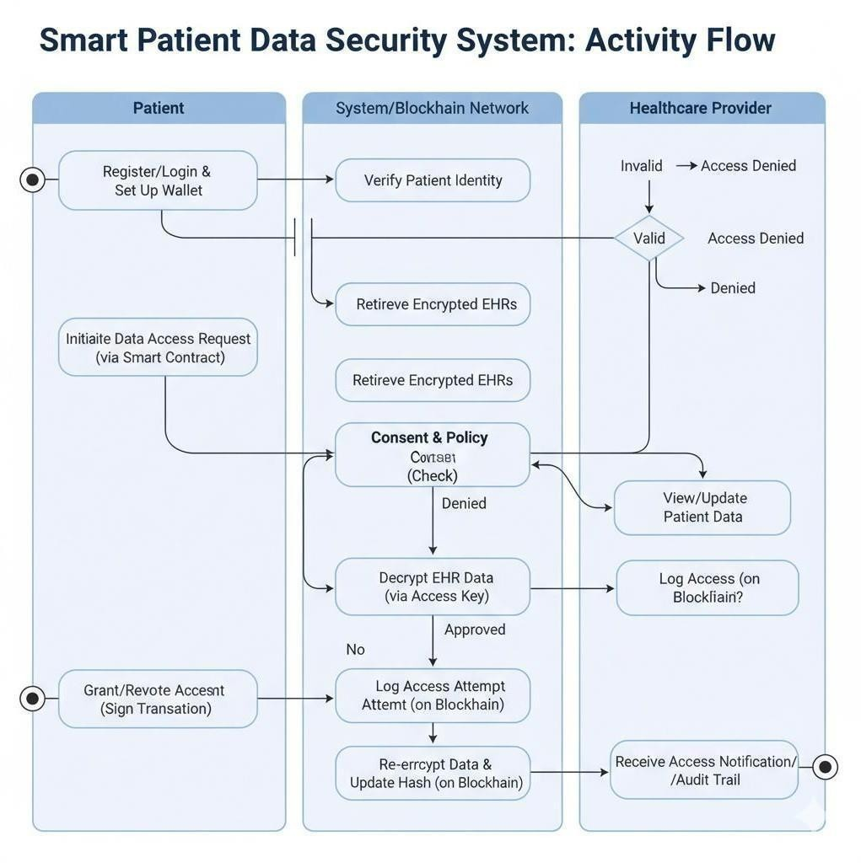
UML DIAGRAM
ACTIVITY DIAGRAM

Slide 10
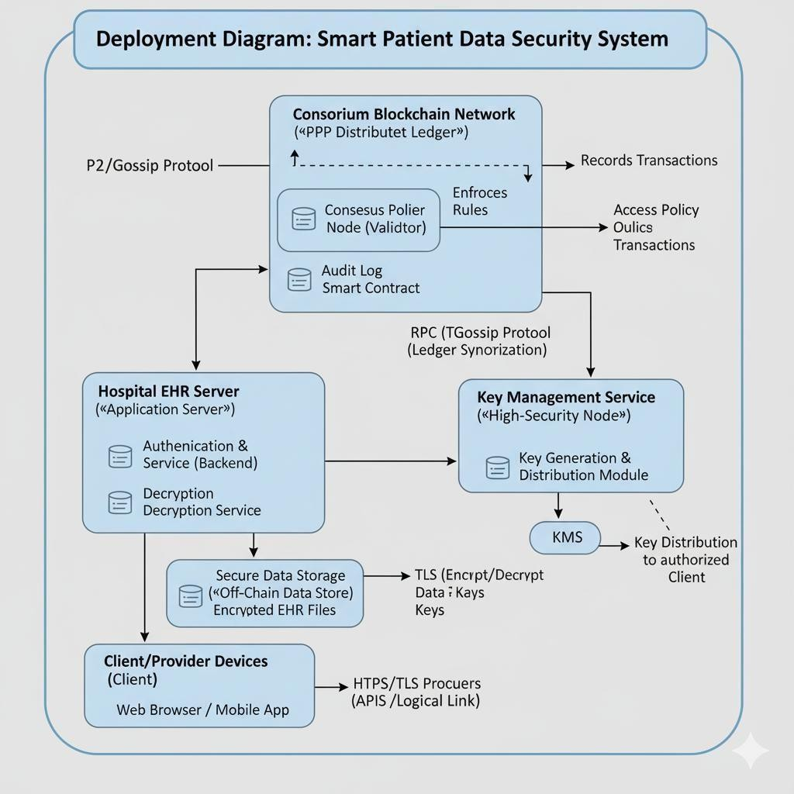
DEPLOYMENT DIAGRAM

Slide 11
MODULE
Home Page – System overview & navigation
About Hospital – Info about hospital & services
Contact Details – Support and communication info
Register Page – New user registration
Login Page – Secure user authentication
Add Record – Add/update patient details
Diagnosis Info – Patient diagnosis data
Login History – Tracks user login activity

Slide 12
TECHNOLOGIES
Frontend: HTML, CSS, JavaScript
Backend: Python
Database: MySQL
Security: Role-Based Access Control
Tools: VS Code, Git, Browser Dev Tools

Slide 13
TESTING
Functional Testing – Verify all modules work as intended (login, add records, diagnosis info).
User Authentication Testing – Ensure only authorized users can access the system.
Data Security Testing – Check encryption and access control mechanisms.
Usability Testing – Ensure easy navigation and user-friendly interface.
Login History Testing – Verify accurate logging of user activities.
Performance Testing – Assess system speed and stability under multiple users.

Slide 14
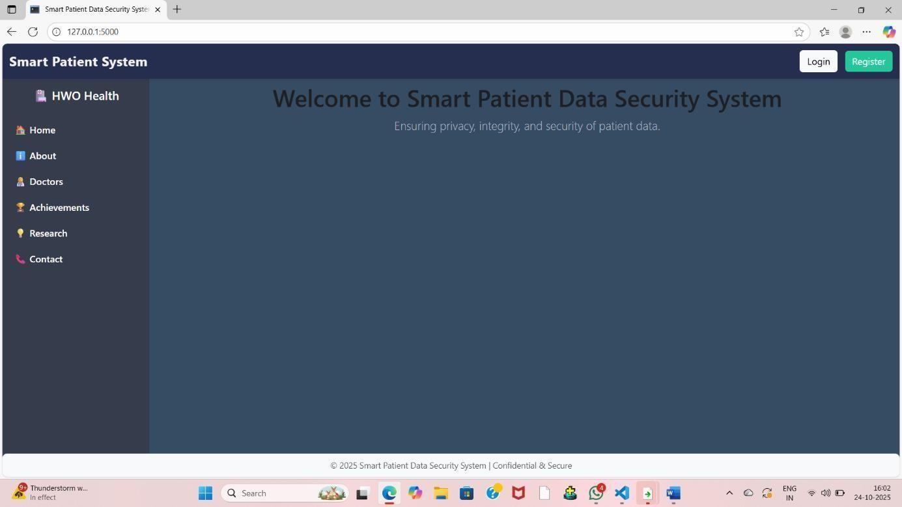
SCREENSHOTS
BASIC HOME PAGE

Slide 15
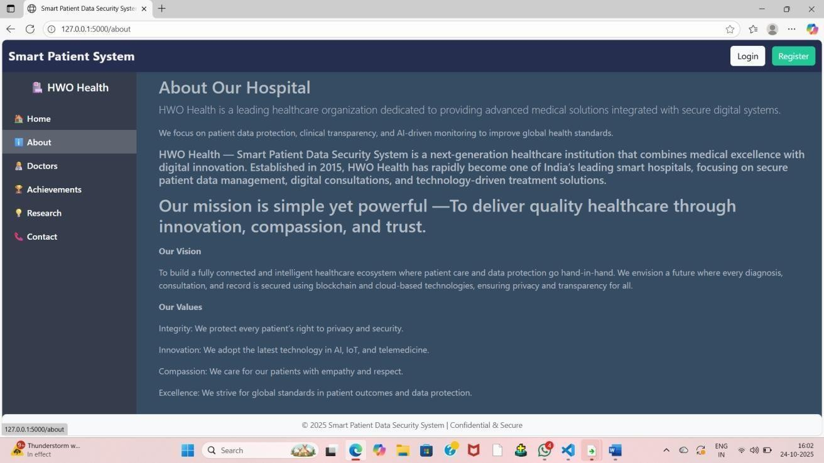
ABOUT PAGE

Slide 16
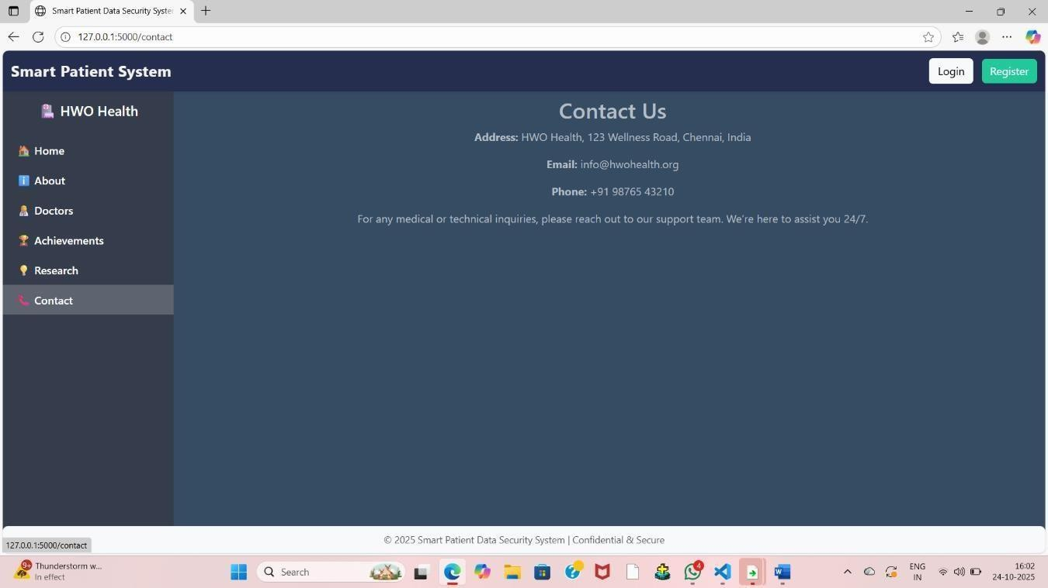
CONTACT DETAILS

Slide 17
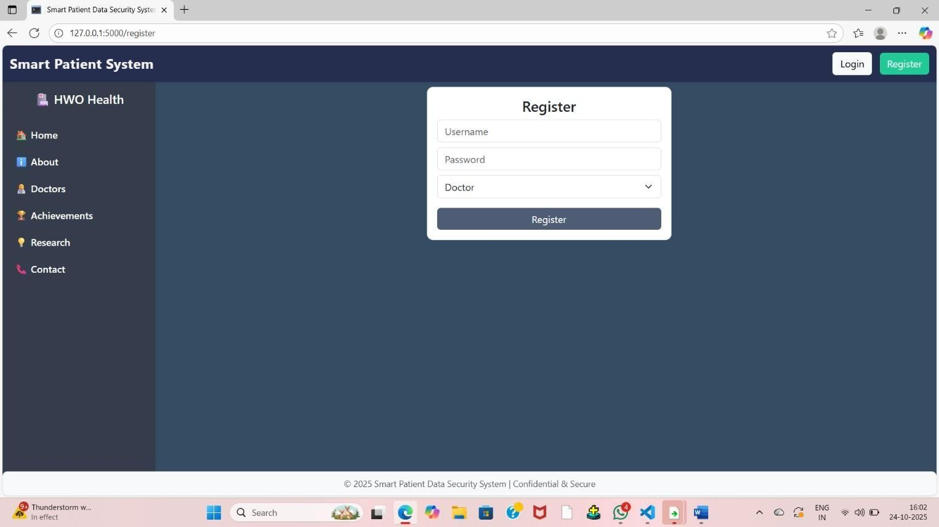
REGISTER PAGE

Slide 18
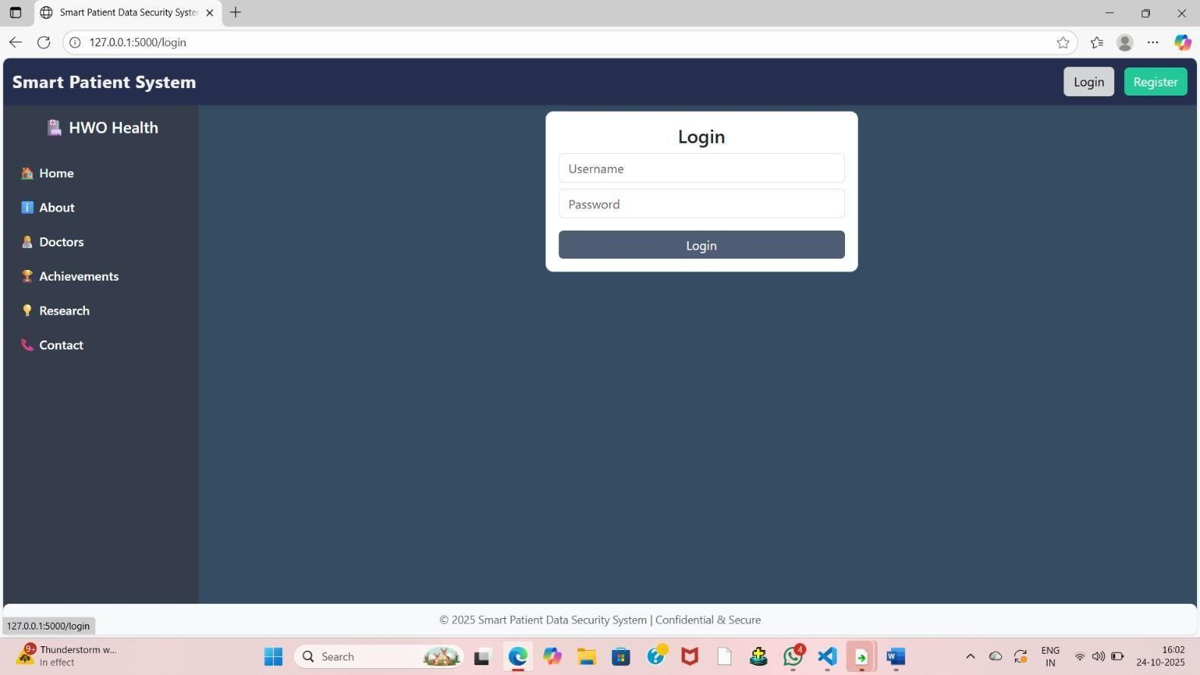
LOGIN PAGE

Slide 19
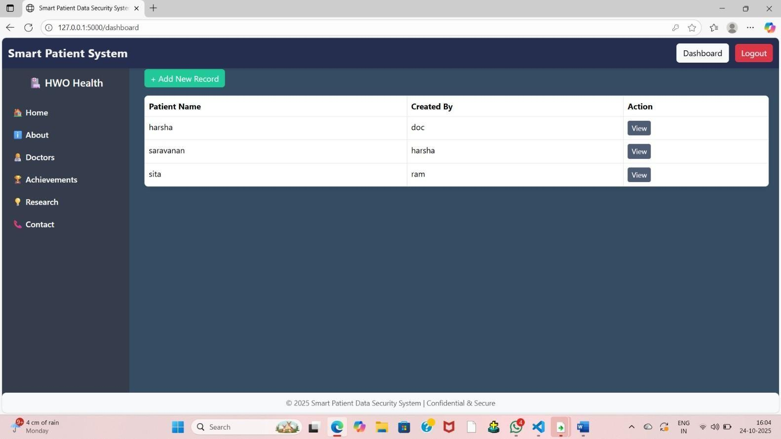
ADD RECORD PAGE

Slide 20
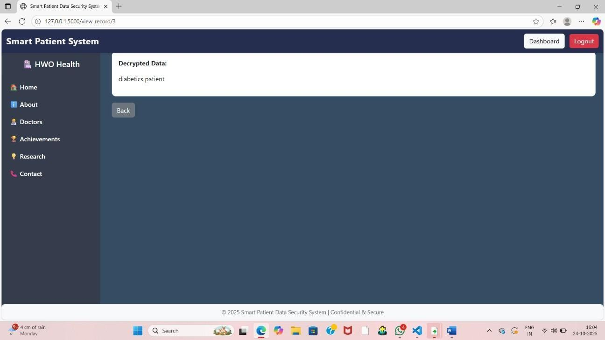
DIAGNOSIS INFO

Slide 21
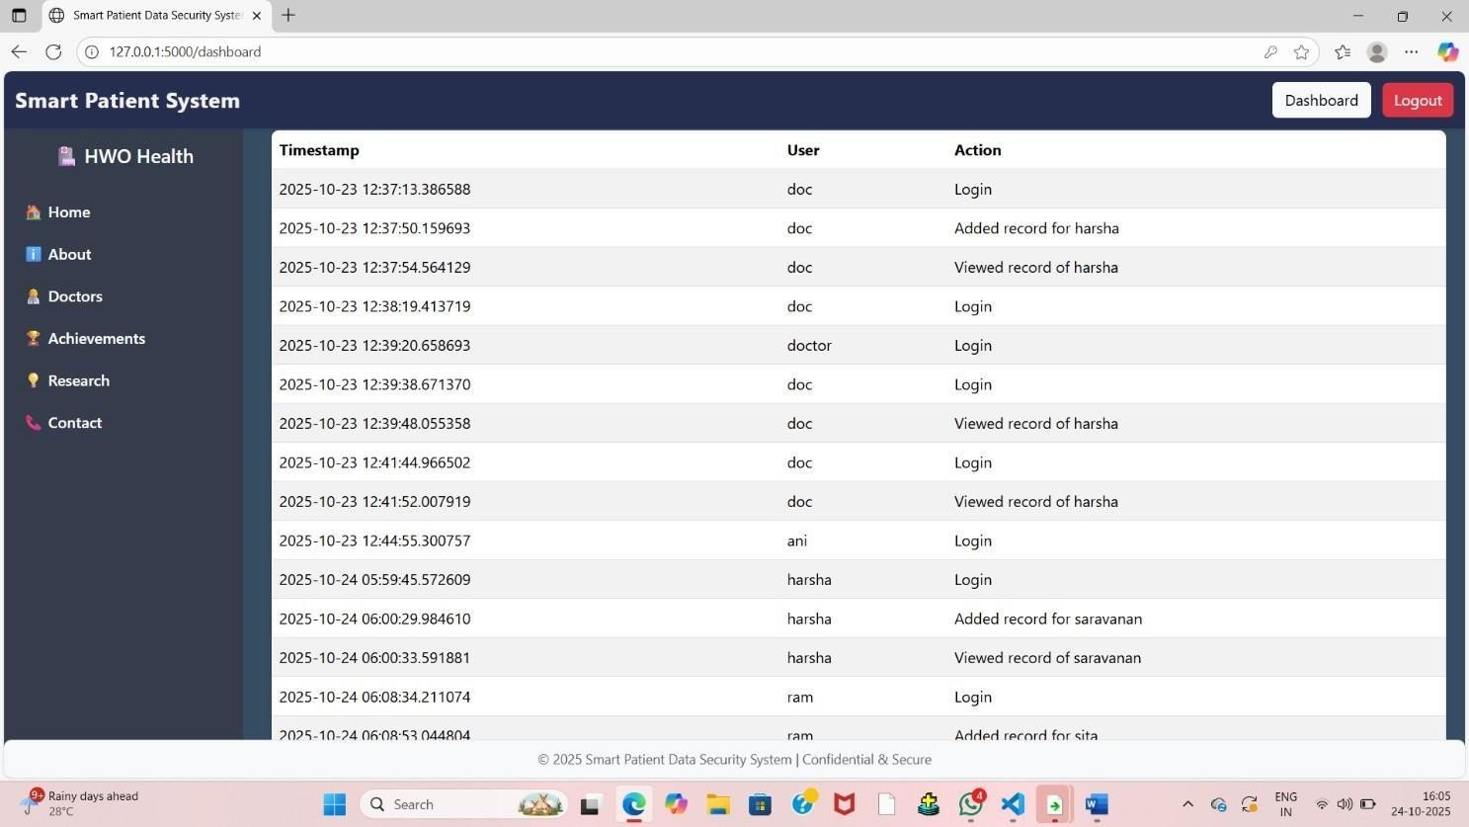
LOGIN HISTORY

Slide 22
CONCLUSION
The system ensures secure handling of patient data in digital healthcare.
Protects information through encryption, authentication, and access control.
Reduces risks of data breaches and unauthorized access.
Promotes trust, efficiency, and privacy in hospital data management.
Lays a strong foundation for future smart and secure healthcare systems.

Slide 23
Future Work
Integrate AI-based threat detection for proactive security.
Implement blockchain for tamper-proof data storage.
Add biometric authentication for stronger user verification.
Develop a mobile app for easy and secure access.
Enable data analytics for medical insights and predictions.

Slide 24
References
Journal Paper:
EHR Access Auditing with Blockchain, Elsevier, 2024
Projects & Code:
HIE of One – Patient-controlled EHR (Open-source)
Resources:
IEEE, Springer, ScienceDirect papers
Textbook: Intro to Modern Cryptography – Katz & Lindell
Survey: Blockchain in EHRs (JETIR, 2024)

Slide 25
Thank you
Question & Answers

